Slide 1

Spark Data Processing and DC/OS
Part I: Getting started with Spark and exploring a sampling of data tools
Presented by Mark Johnson

Slide 2
Spark on DC/OS Overview
Support polygot database analytics
In memory emphasis improves query performance
Compatible with wide range of tools
Finance - Spark 1.6.2
finance - Spark 2.2
Eng- Spark 2.1
Eng- Spark 2.2
DC/OS Cluster
Notes:
Scalable programs without programming
Consistent DNS connections
Programs run the same on dev, staging and Production

Slide 3
Agenda
Installing and configuring Spark on DC/OS
Running Spark Programs
Debugging and Monitoring
Spark Data Access
Spark Data Notebooks

Slide 4
Part I: Spark Installation & Setup

Slide 5
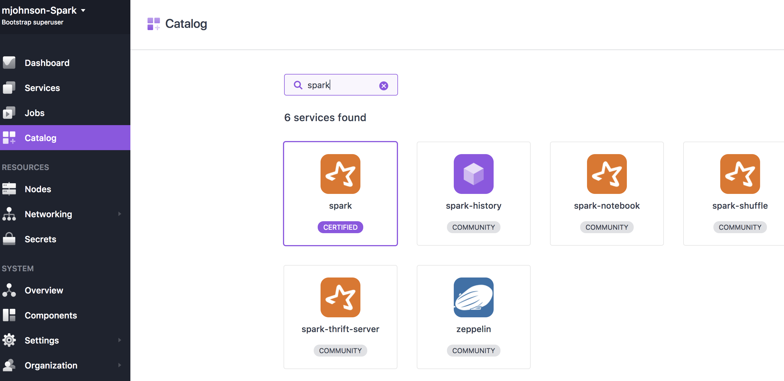
GUI Based Spark installation

Slide 6
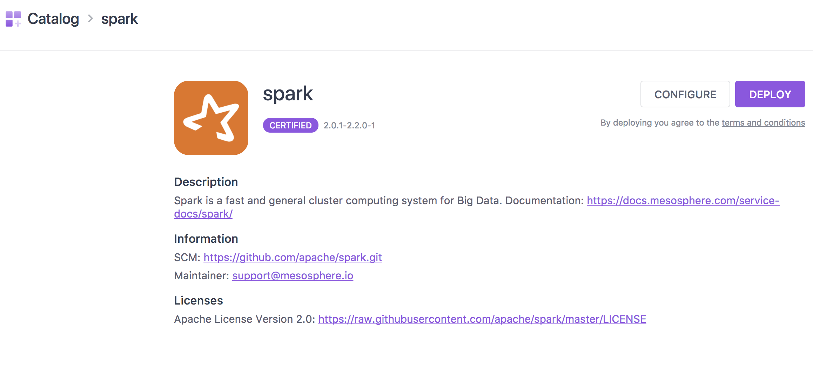

Slide 7
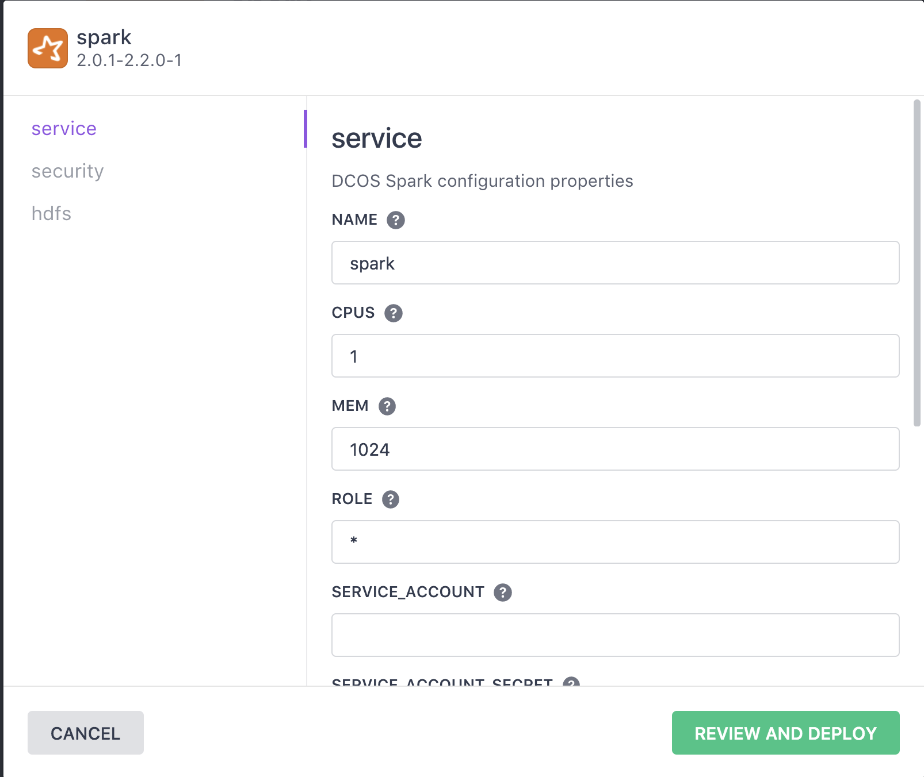

Slide 8
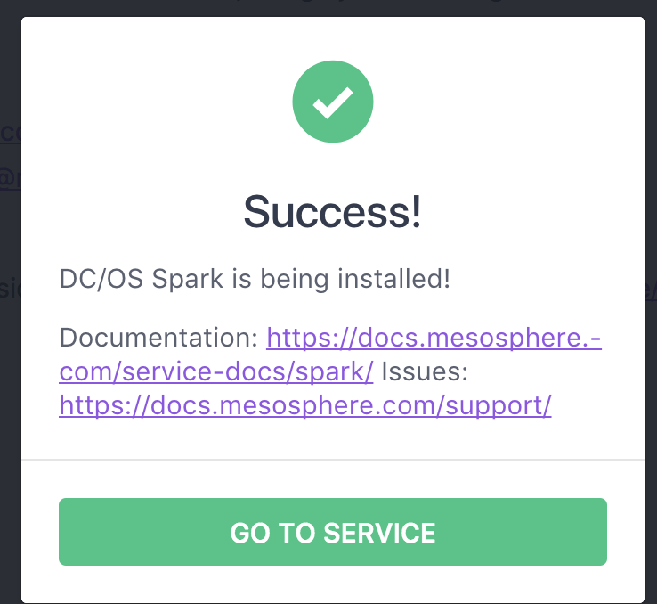

Slide 9
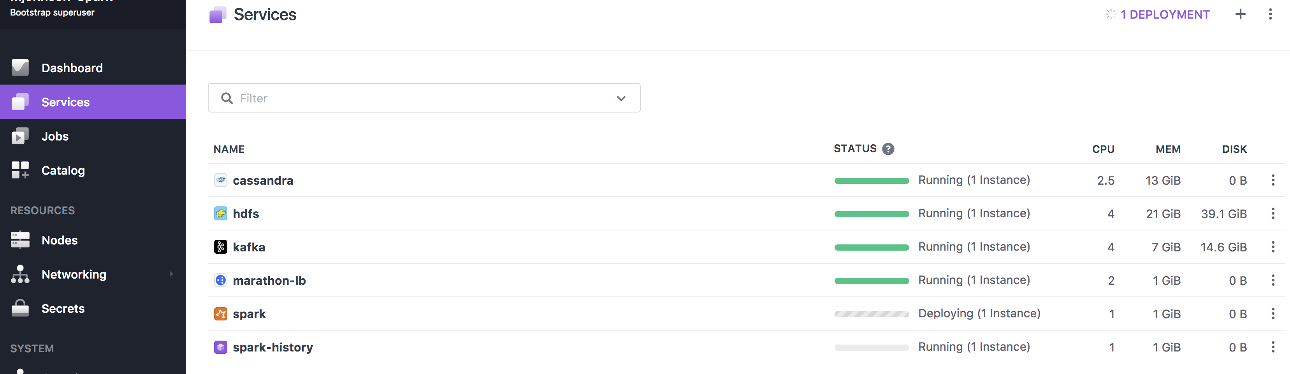

Slide 10
Command Line Spark Installation
dcos package install spark --app-id=/production
dcos package install spark --package-version=1.0.1-1.6.2 --app- id=/spark162
dcos package install --yes spark --options=spark-dispatcher-options.json

Slide 11
DC/OS Spark Command Line Options
dcos spark run …
dcos spark status {submission id}
dcos spark log {submission id}
dcos spark kill {submission id}
dcos webui

Slide 12
Part II: Running Spark Programs

Slide 13
Run Spark from the command line
dcos spark run --submit-args="--conf spark.mesos.executor.docker.image=mesosphere/spark:1.1.0-2.1.1-hadoop-2.6 https://downloads.mesosphere.com/spark/examples/pi.py 30" --verbose

Slide 14
Run Spark from the command line
dcos spark run --submit-args="--conf spark.mesos.executor.docker.image=mesosphere/spark:1.1.0-2.1.1-hadoop-2.6 https://downloads.mesosphere.com/spark/examples/pi.py 30" --verbose

Slide 15
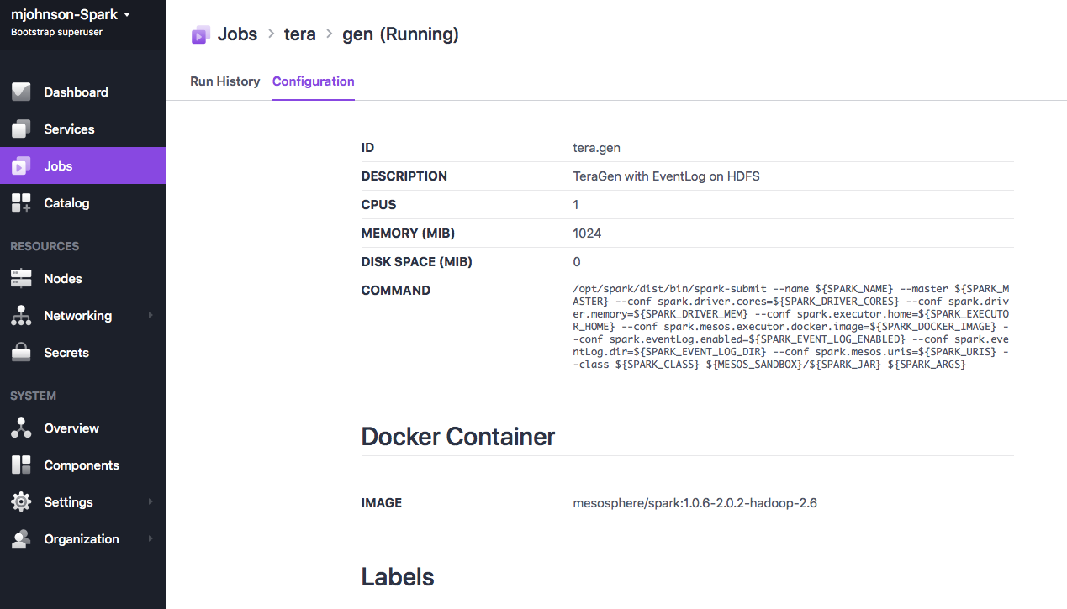
DC/OS Jobs

Slide 16
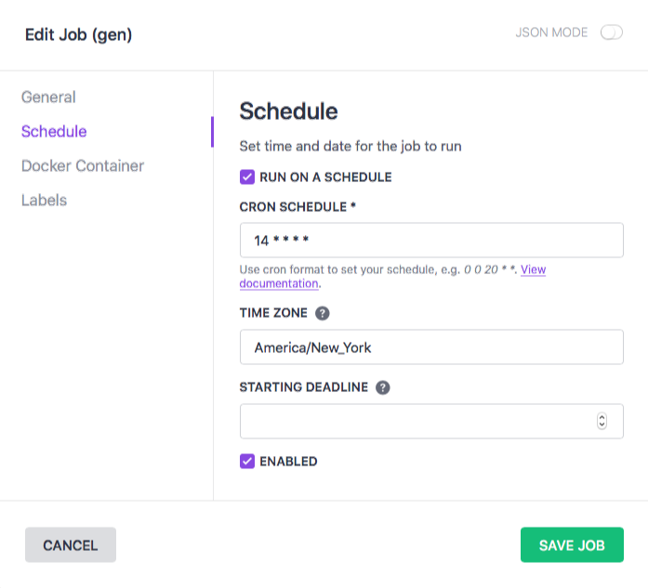
Run every 15 minutes

Slide 17
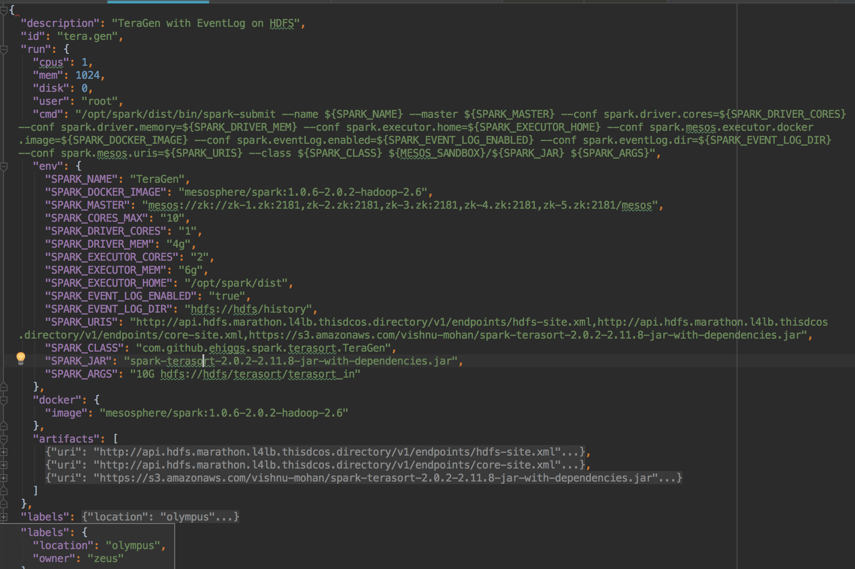
DC/OS Jobs

Slide 18
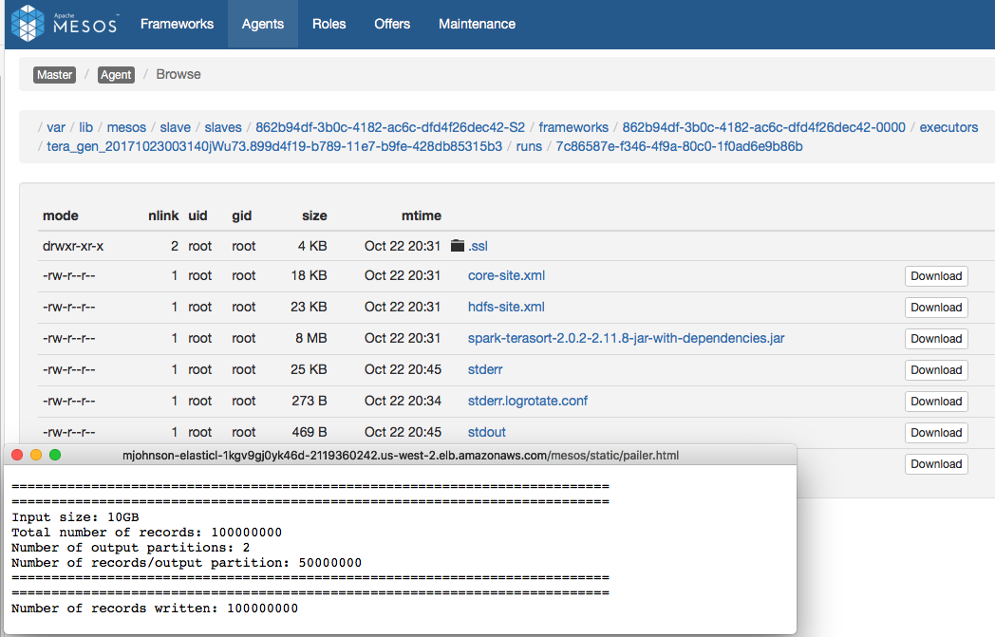
Mesos Sandbox : Job Output

Slide 19
Park III: Spark Debugging and Monitoring

Slide 20
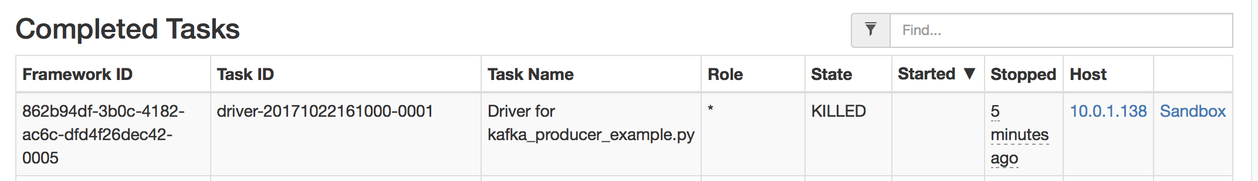
Mesos Task Screen

Slide 21
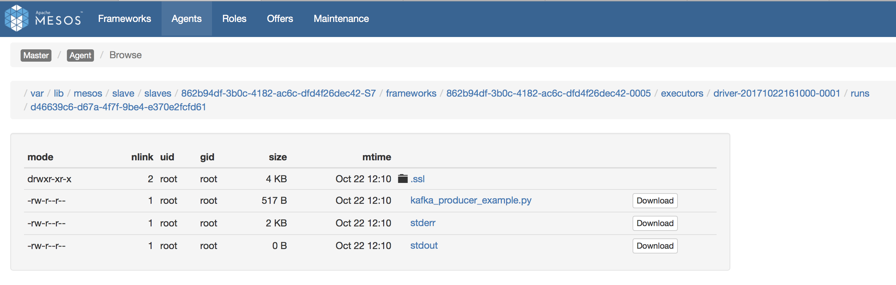
Mesos Sandbox

Slide 22
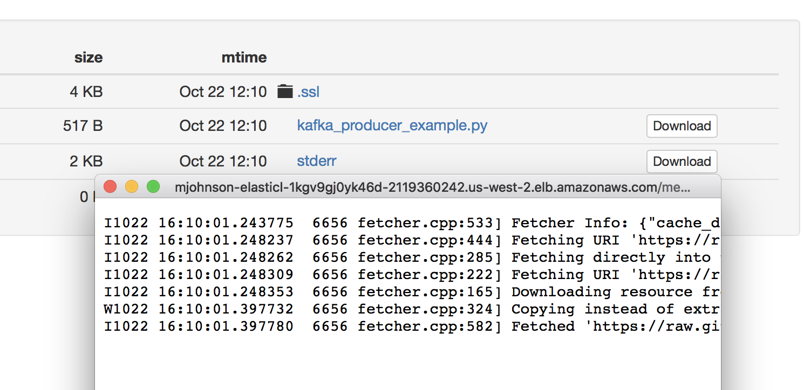
Mesos Sandbox: Viewing Logs

Slide 23
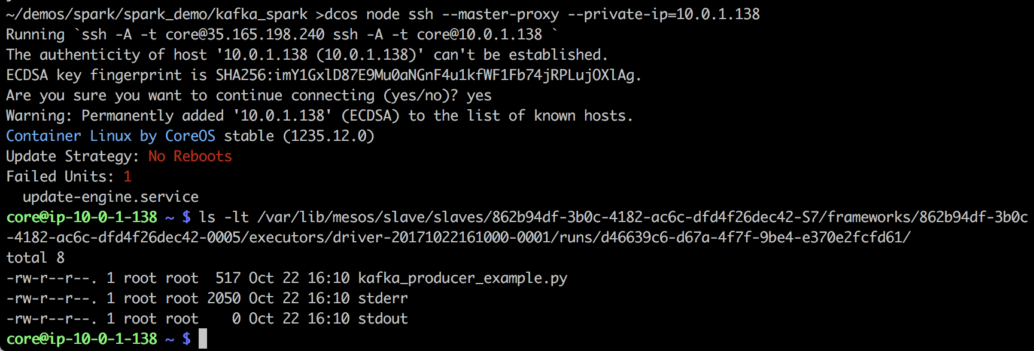
View Sandbox on Host

Slide 24
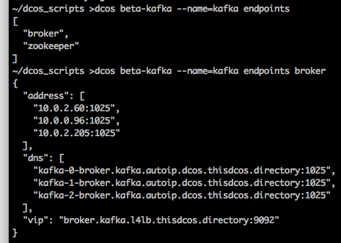
SSH TUNNELS - Spark Program Debugging
Ssh –N –L {desired port}:{DC/OS VIP or DNS}:{Endpoint Port} {user id}{dc/os url}
Use ‘dcos {framework} endpoints {desired endpoint}’ to identify the VIP or DNS options.
Change your source program to reference ‘localhost:{desired port}’
from kafka import KafkaConsumer, KafkaProducer from kafka.errors import KafkaError #kafka_url = "broker.kafka.l4lb.thisdcos.directory:9092" kafka_url = "localhost:9092" topic_name = "example_topic" def readTopic(): consumer = KafkaConsumer(bootstrap_servers=kafka_url, auto_offset_reset='earliest', group_id="PrimaryGroup", client_id="client-1", enable_auto_commit=True, api_version=(0,10))

Slide 25
Spark History

Slide 26
Part IV: Data Access with Spark

Slide 27
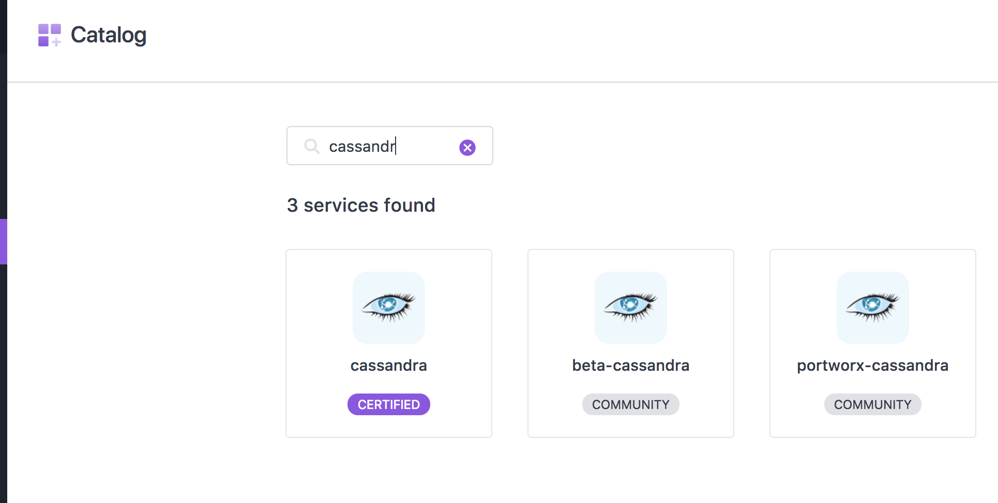
Spark & Cassandra

Slide 28
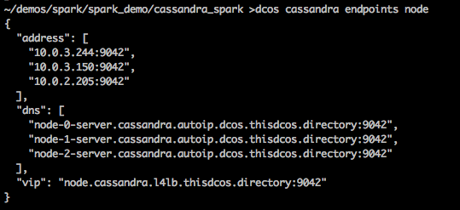
Cassandra DC/OS Addresses

Slide 29
Cassandra SQL Execute Example
from cassandra.cluster import Cluster from pyspark import SparkContext, SparkConf, SQLContext from pyspark.sql import SparkSession cassandra_url = 'node.cassandra.l4lb.thisdcos.directory:9042' #cassandra_url = 'localhost' spark = SparkSession.builder \ .appName("PySpark Cassandra Read Write Example") \ .config("spark.sql.crossJoin.enabled", "true") \ .getOrCreate() cluster = Cluster([cassandra_url]) session = cluster.connect() session.execute("""CREATE KEYSPACE IF NOT EXISTS dcos_example WITH REPLICATION = { \'class\' : 'NetworkTopologyStrategy', 'datacenter1' : 3 }; """) session.execute("USE dcos_example;") session.execute("CREATE TABLE IF NOT EXISTS sample_table ( user_id timeuuid PRIMARY KEY, added_date timestamp, first_name text, last_name text, email text);")

Slide 30
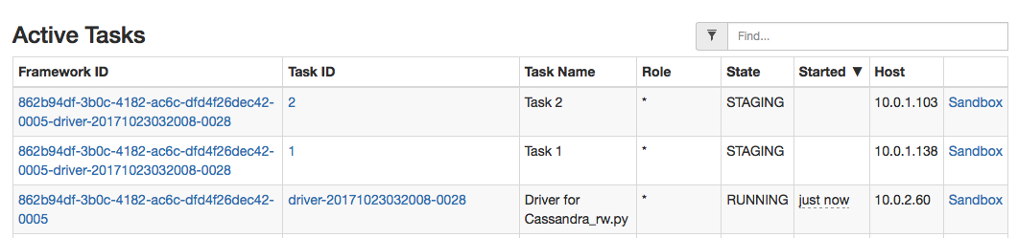
Spark tasks and driver

Slide 31
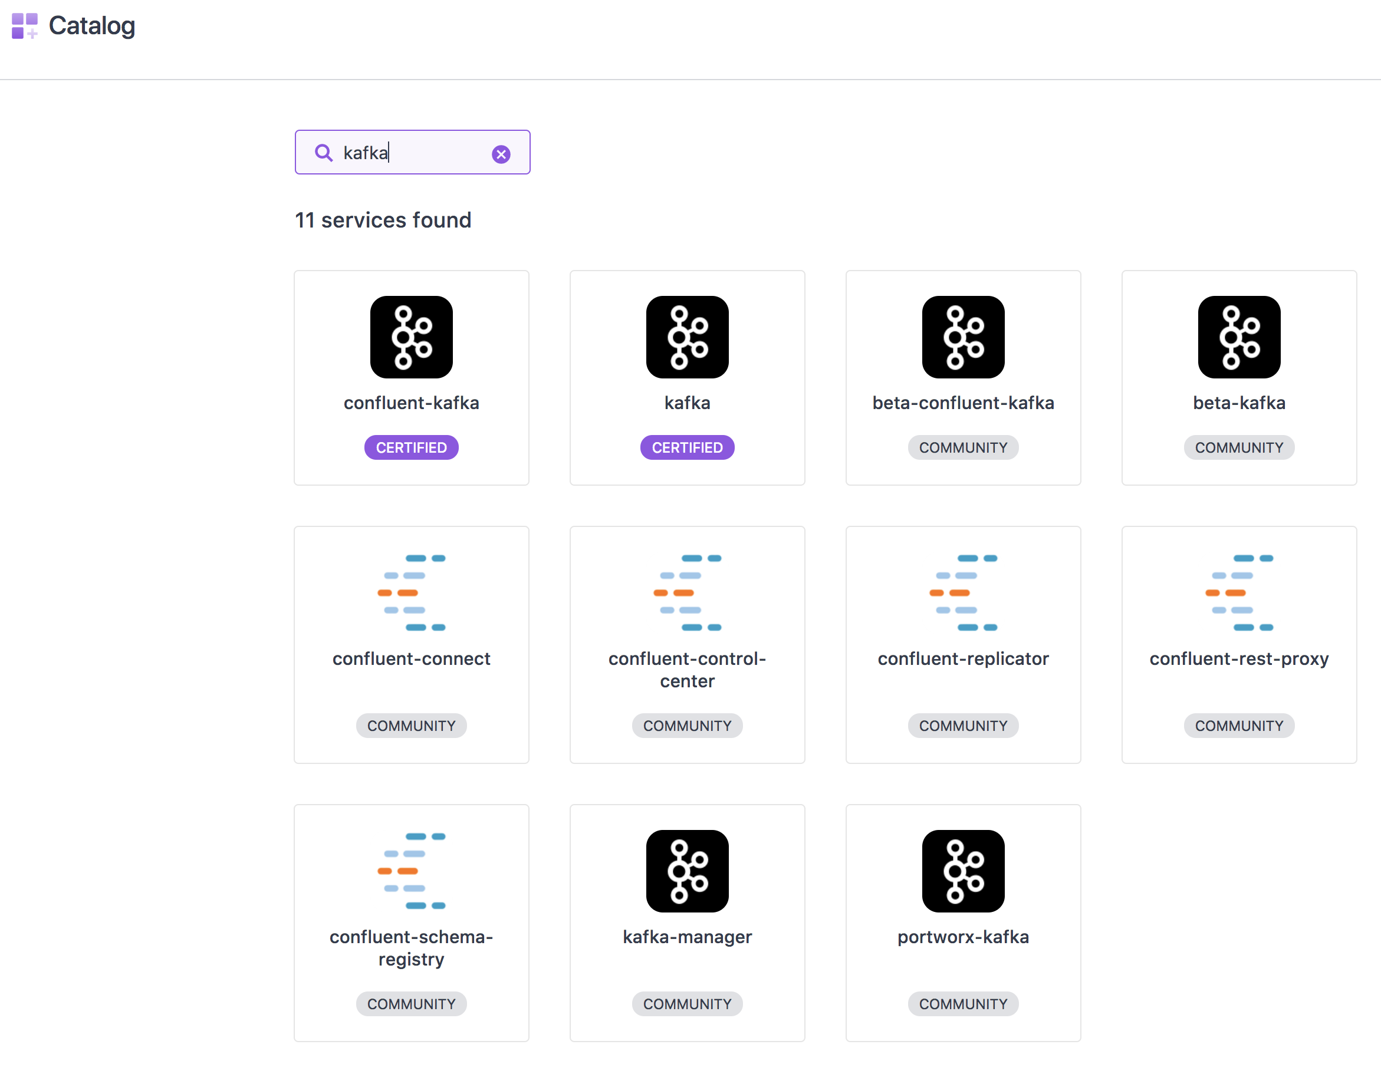
Spark & Kafka

Slide 32
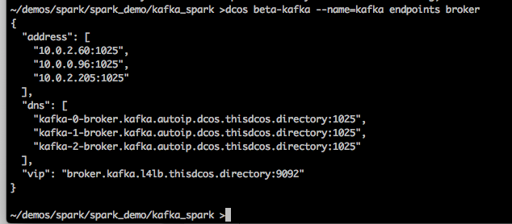
Identify Kafka Broker Endpoints

Slide 33
Kafka Producer
from kafka import KafkaProducer import time kafka_url = ["kafka-0-broker.kafka.autoip.dcos.thisdcos.directory:1025","kafka-1-broker.kafka.autoip.dcos.thisdcos.directory:1025", "kafka-2-broker.kafka.autoip.dcos.thisdcos.directory:1025"] topic_name = "example_topic" p = KafkaProducer(bootstrap_servers=kafka_url,api_version=(0,10)) iter_count = 0 while True: msg = b"test message - {}".format(iter_count) print msg p.send(topic_name, msg) time.sleep(1) iter_count = iter_count + 1

Slide 34
Kafka Consumer
om kafka import KafkaConsumer print("Start of Kafka consumer program") kafka_url = "broker.kafka.l4lb.thisdcos.directory:9092" #kafka_url = "localhost:9092" topic_name = "example_topic" print("Connecting to {}".format(kafka_url)) consumer = KafkaConsumer(topic_name, bootstrap_servers=kafka_url, group_id="PrimaryGroup", enable_auto_commit=True, api_version=(0,10)) print ('Start consuming') for message in consumer: print(message) print("Done consuming")

Slide 35
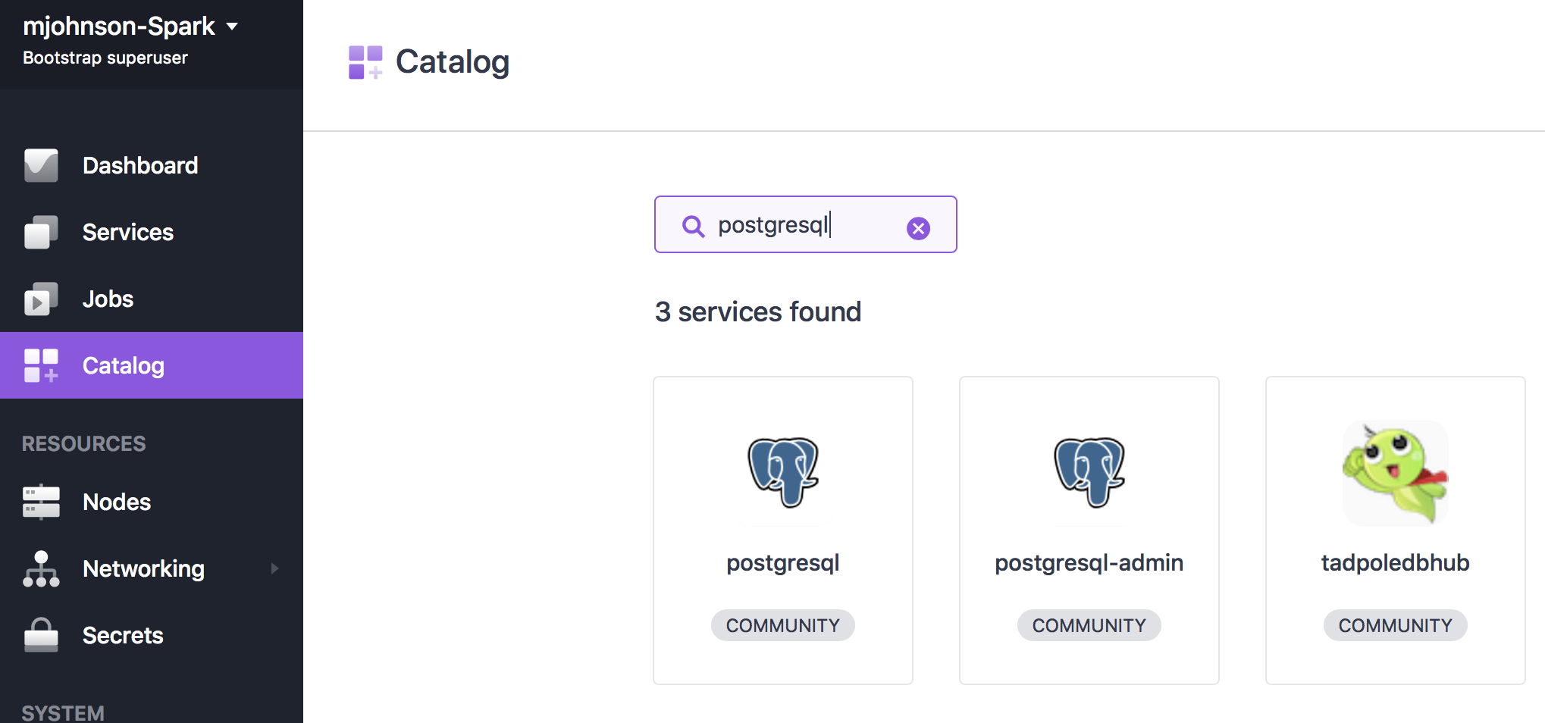
PostgresQL

Slide 36
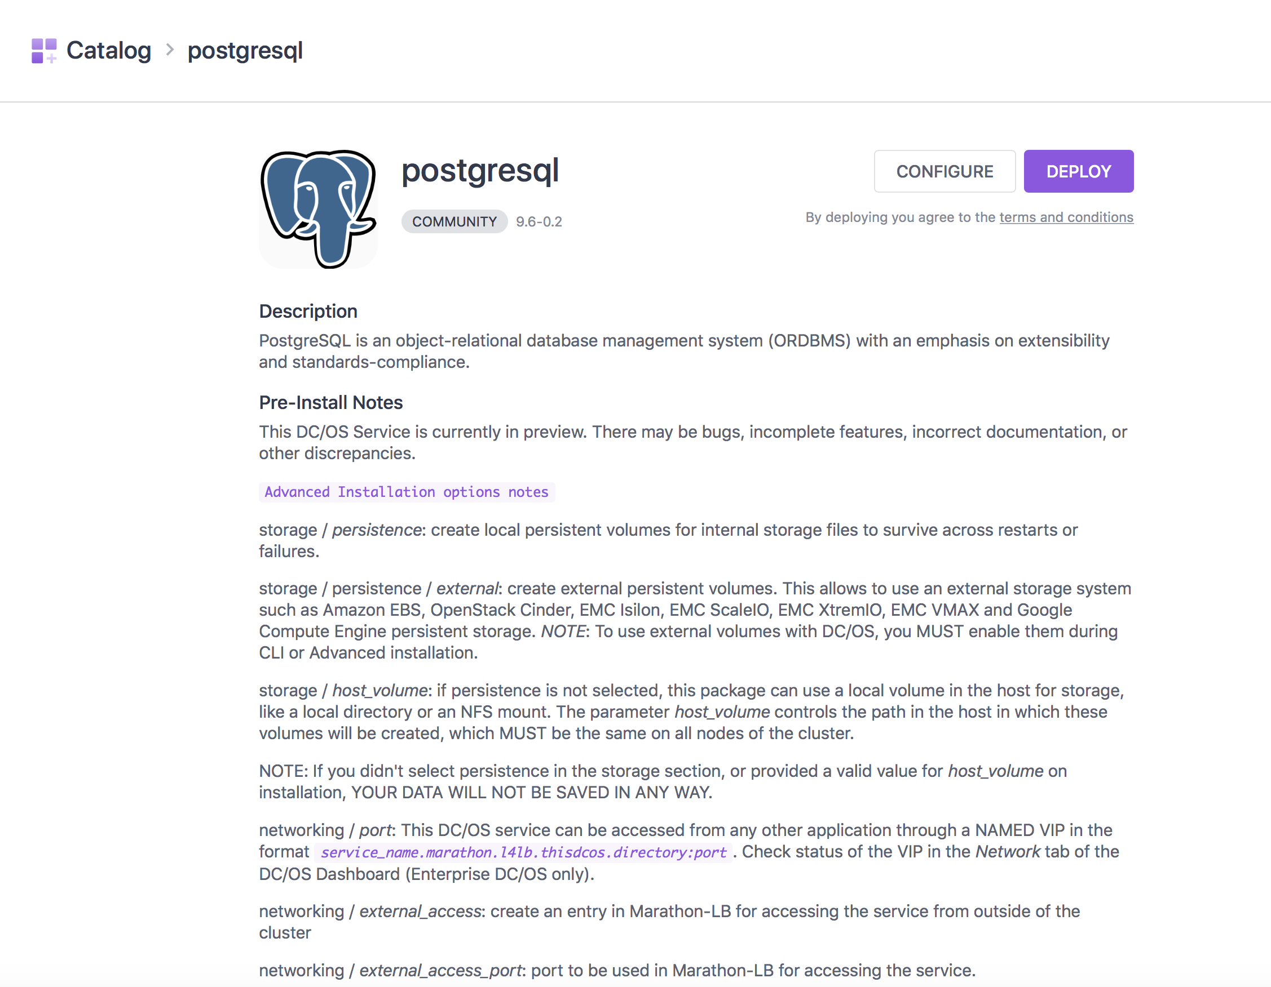

Slide 37
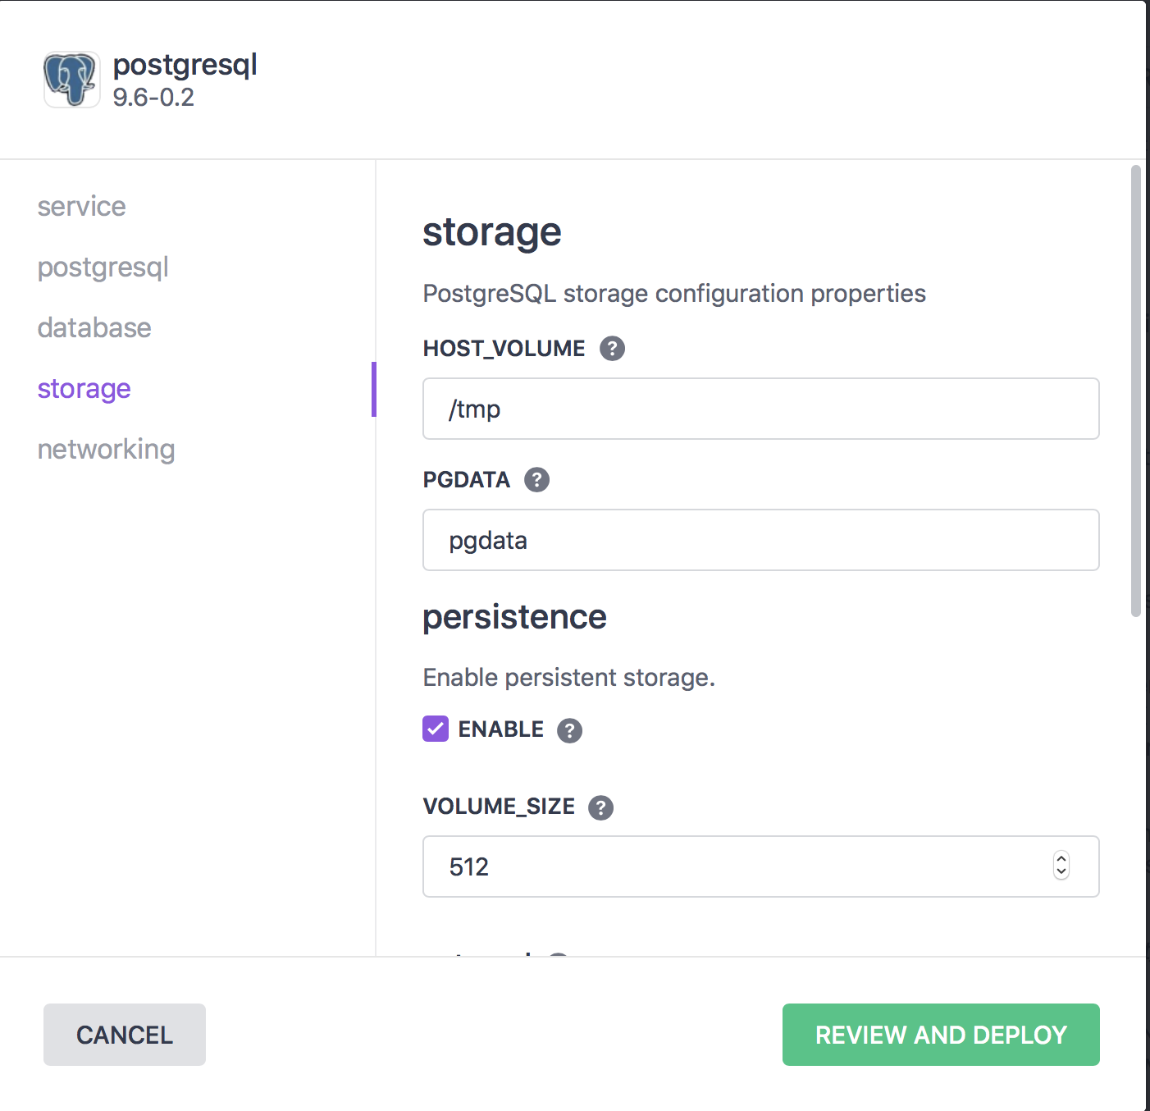
PostgresQL - Storage

Slide 38
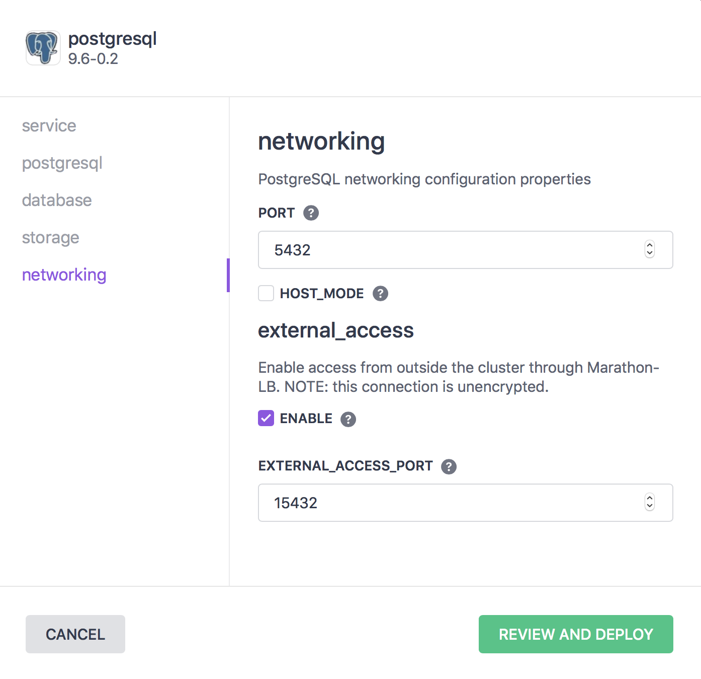
PostgresQL – Networking – EXTERNAL ACCESS

Slide 39
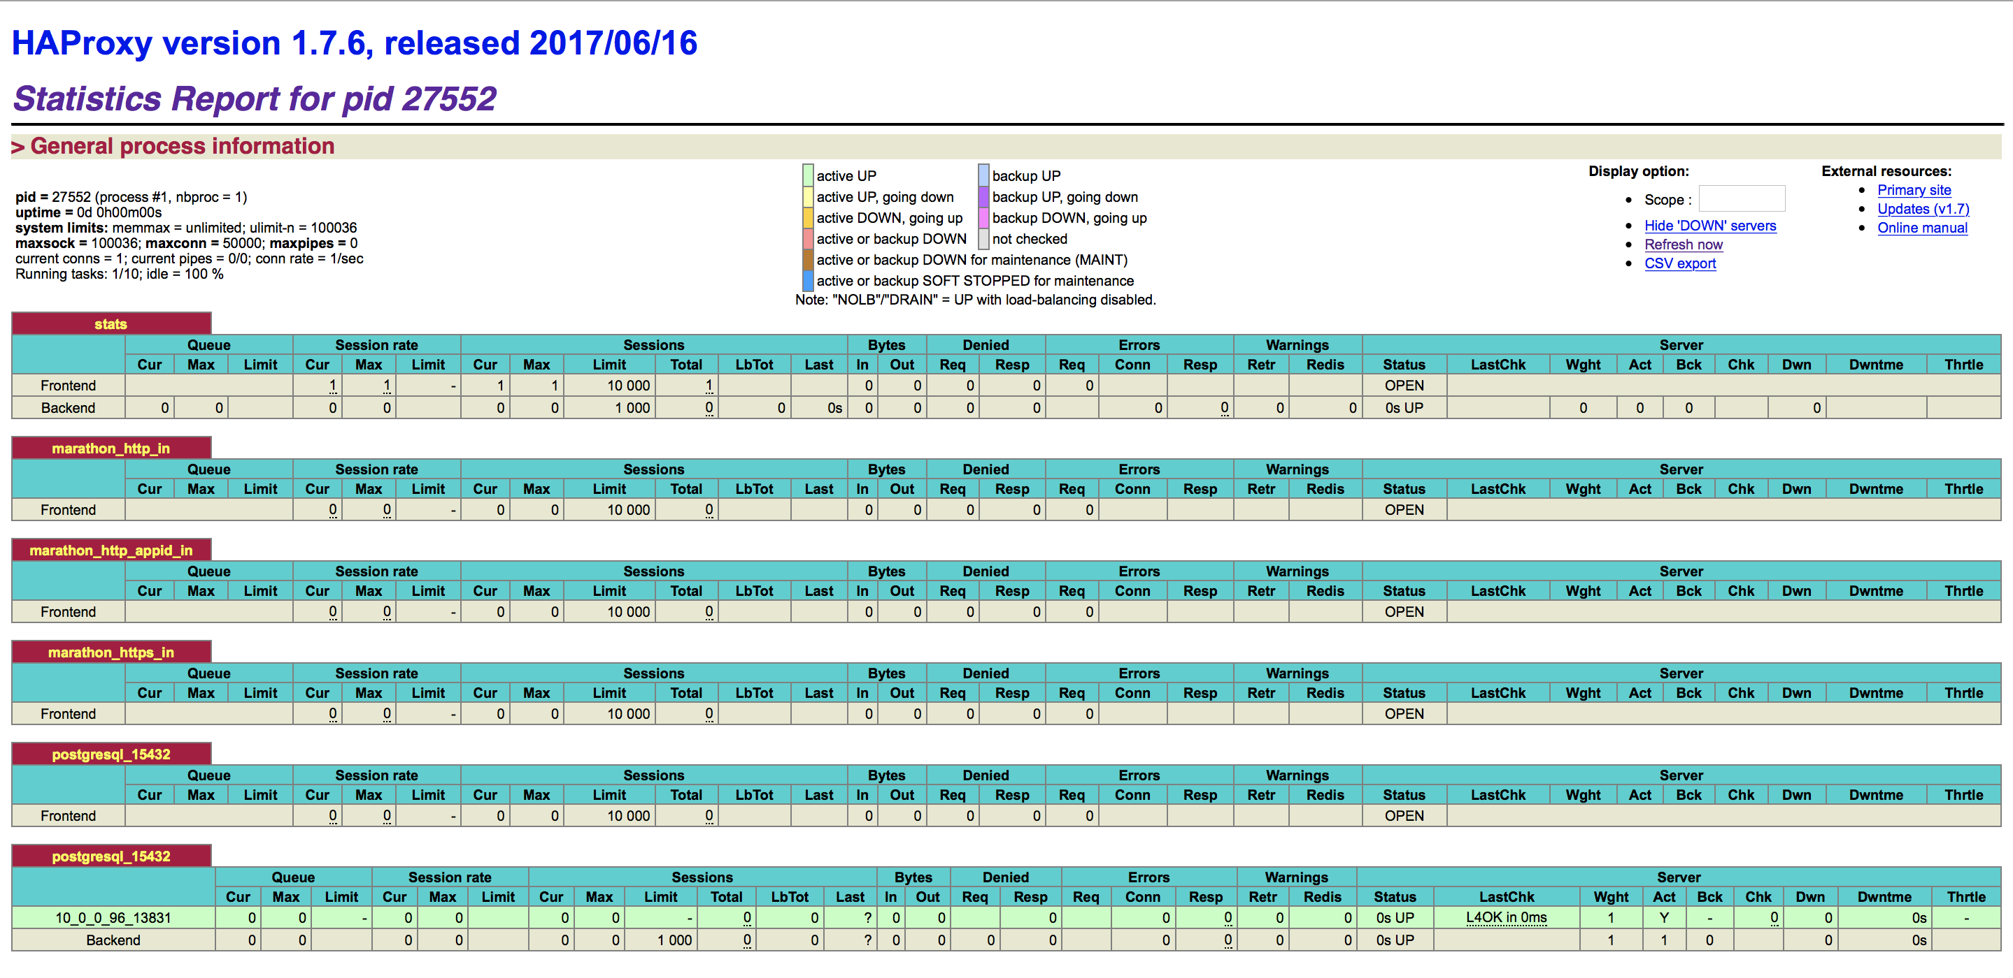
External access PostgresQL

Slide 40
PostgresQL Example Program
import psycopg2 import sys from psycopg2.extensions import ISOLATION_LEVEL_AUTOCOMMIT con = None host = "34.215.42.192" psql_port = "15432" try: con = psycopg2.connect("host='{}' dbname='postgres' user='admin' password='password' port={}".format(host,psql_port)) con.set_isolation_level(ISOLATION_LEVEL_AUTOCOMMIT) cur = con.cursor() cur.execute("CREATE DATABASE test_db;") cur.execute("CREATE TABLE link (ID serial PRIMARY KEY, url VARCHAR (255) NOT NULL, name VARCHAR (255) NOT NULL," + "description VARCHAR (255),rel VARCHAR(50)); ") cur.execute("INSERT INTO link (url, name) VALUES('http://www.postgresqltutorial.com','PostgreSQL Tutorial');") con.commit() except psycopg2.DatabaseError, e: if con: con.rollback() print 'Error %s' % e sys.exit(1) finally: if con: con.close()

Slide 41
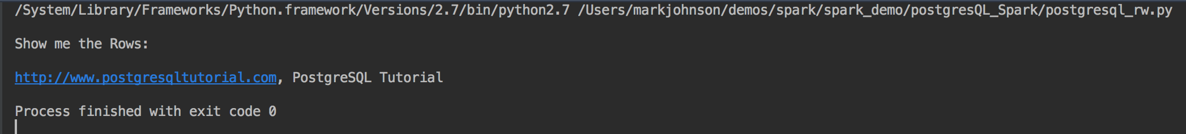

Slide 42
Spark & HDFS

Slide 43
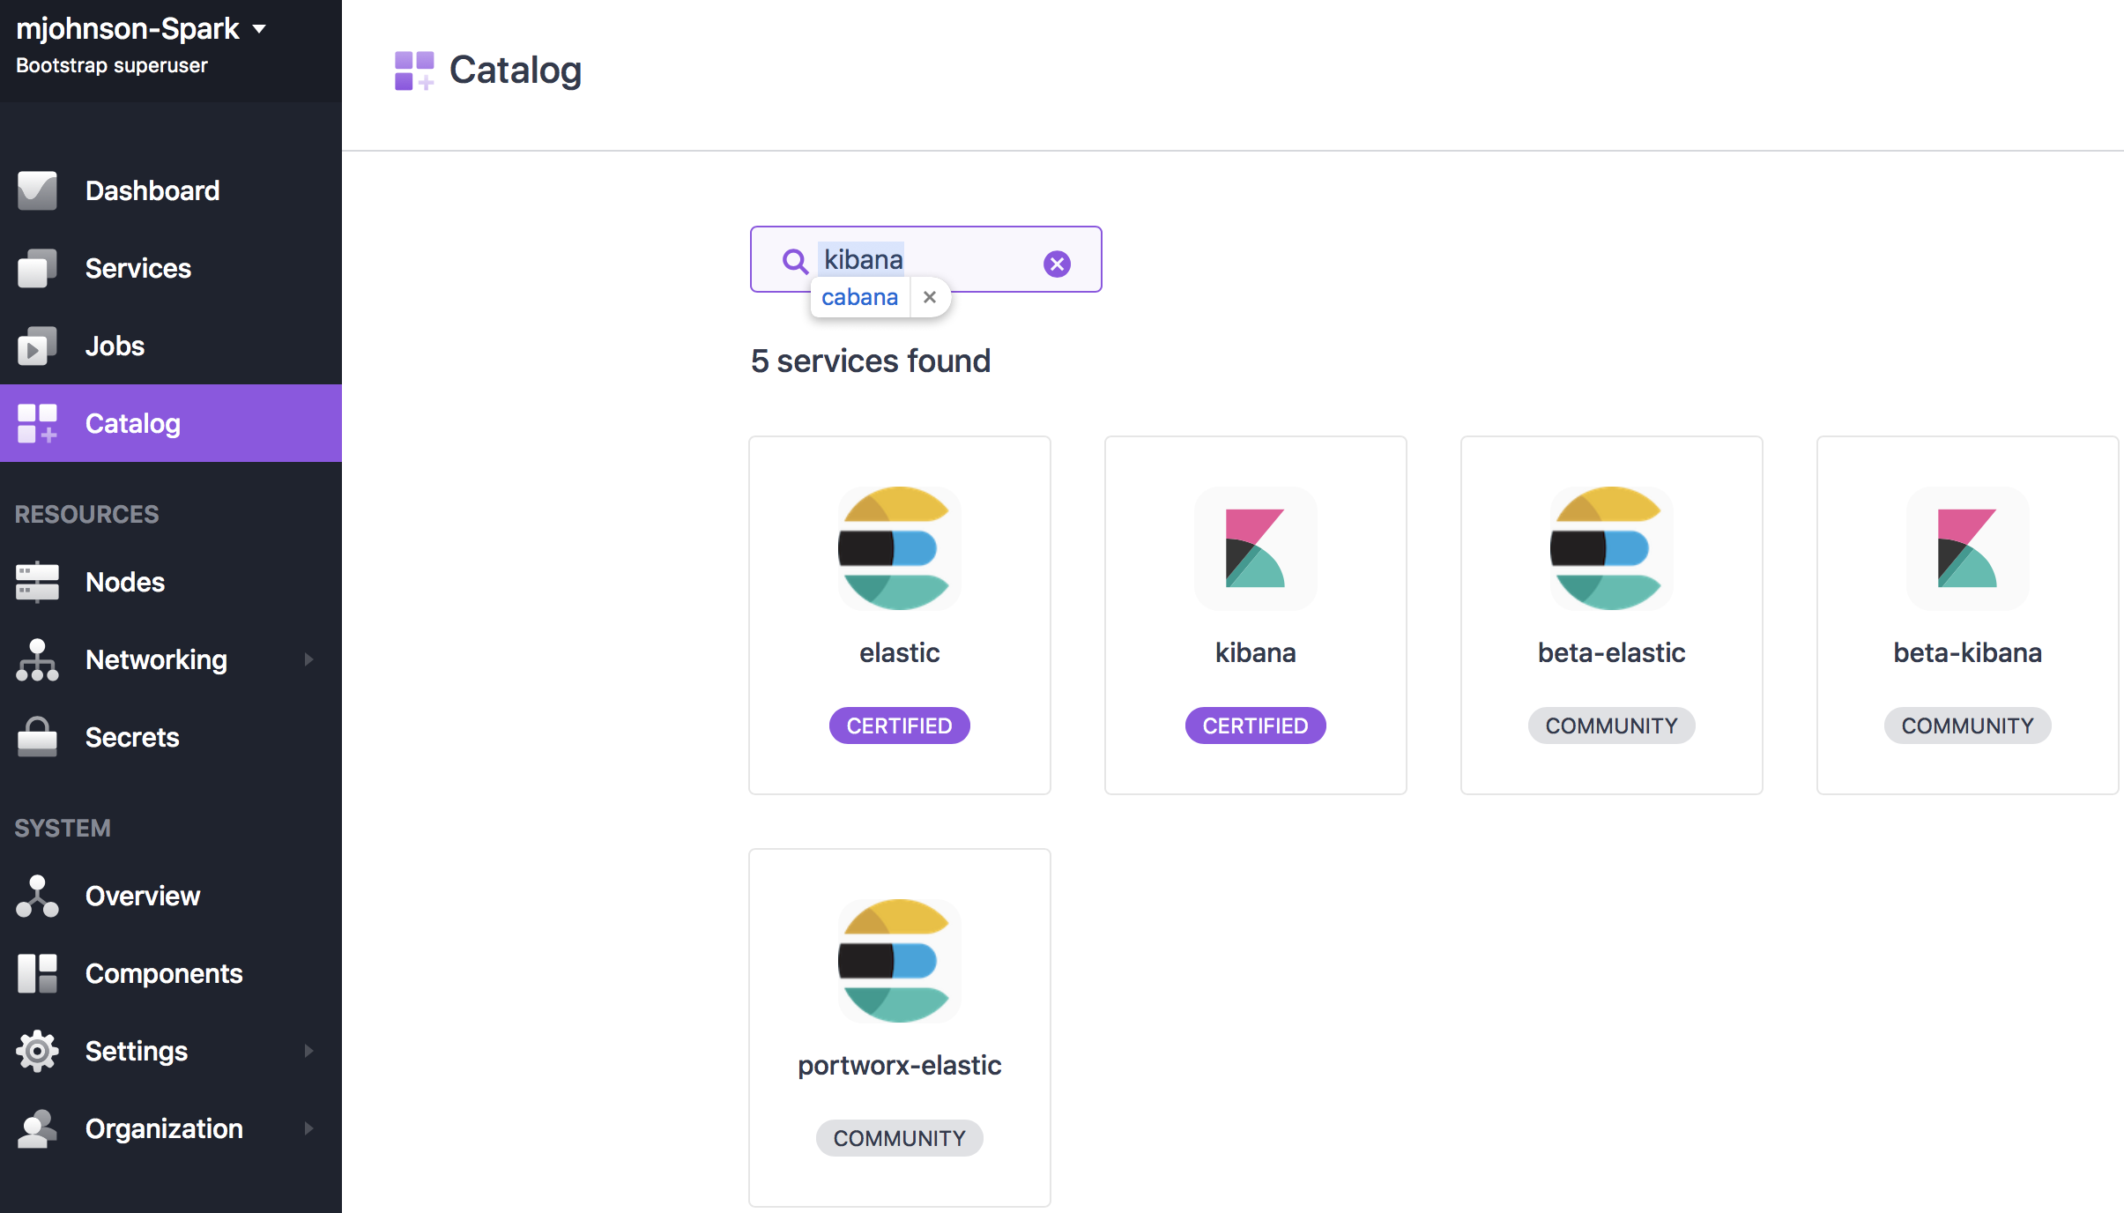
Spark & Elastic Search

Slide 44
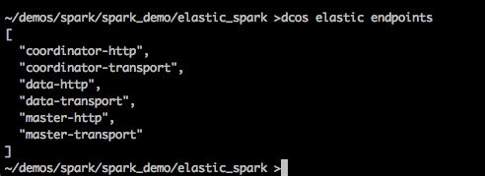
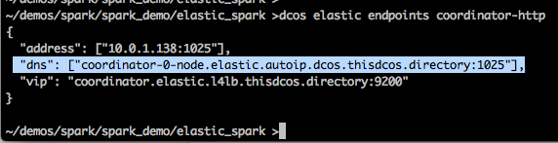
ElasticSearch identify coordinator

Slide 45
ElasticSearch post example
import elasticsearch elastic_url = 'coordinator-0-node.elastic.autoip.dcos.thisdcos.directory' elastic_url = 'localhost' elastic_port = 1025 print('Connecting to Elastic Search url={}, port={}'.format(elastic_url,elastic_port)) es = elasticsearch.Elasticsearch([{'host':elastic_url,'port':elastic_port}]) es.index(index='posts', doc_type='blog', id=1, body={ 'author': 'Santa Clause', 'blog': 'Slave Based Shippers of the North', 'title': 'Using Celery for distributing gift dispatch', 'topics': ['slave labor', 'elves', 'python', 'celery', 'antigravity reindeer'], 'awesomeness': 0.2 })
Use ‘dcos elastic
Example writes to the index posts one entry

Slide 46
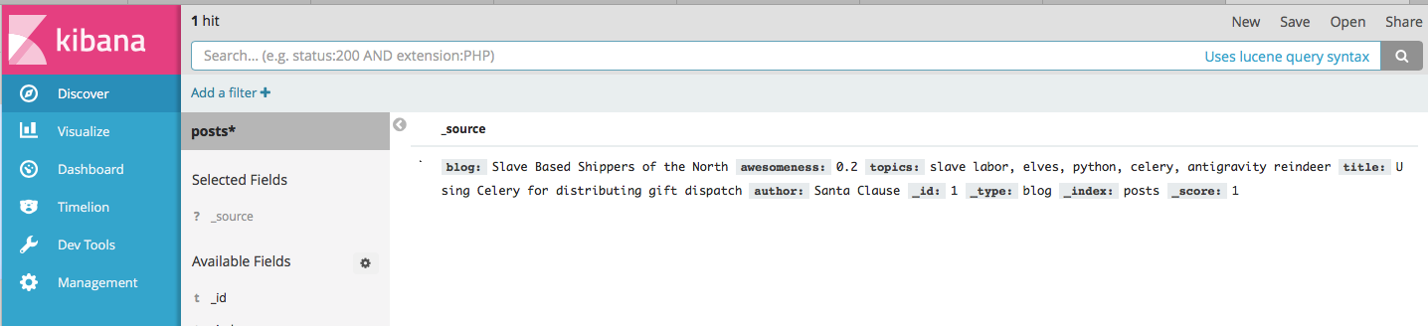
Kibana Search Example

Slide 47
Part V: Spark Notebooks

Slide 48
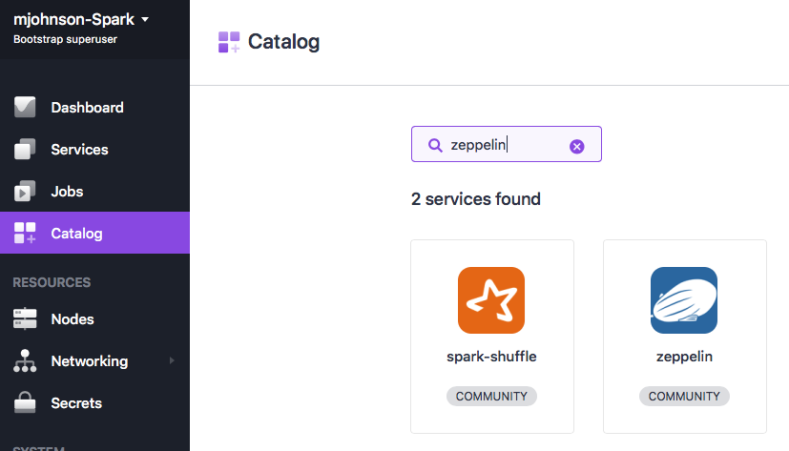
Zeppelin Notebooks

Slide 49
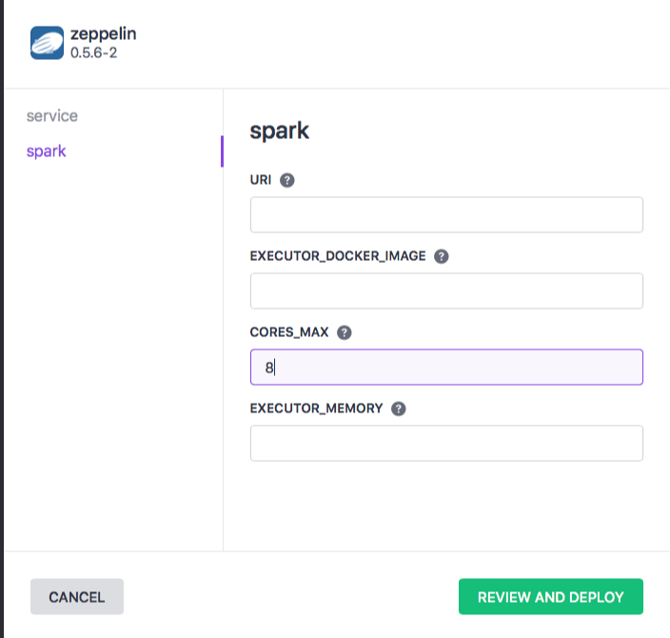

Slide 50
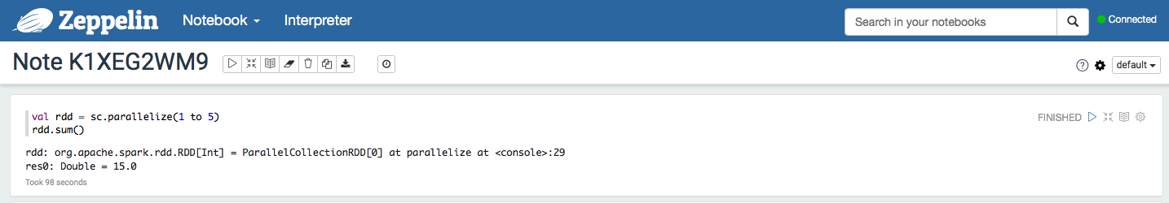

Slide 52
Linking Data sources

Slide 53
Additional Resources
Presentation Examples: https://github.com/markfjohnson/dcos_spark_demo.git
DC/OS Certified Services Documentation: https://docs.mesosphere.com/service-docs/
Zeppelin Examples Doc: https://github.com/dcos/examples/tree/master/zeppelin/1.9
Misc Examples: www.dcosexamples.com
Mesosphere Blog: https://mesosphere.com/blog/
Developers Guide to the Universe: https://mesosphere.com/blog/a-developers-guide-to-the-universe/

Slide 54
Spark and DC/OS
Next Session: Spark Security & HDFS Programming
Presented by Mark Johnson

Slide 55
MESOSPHERE DC/OS ENTERPRISE FEATURES
1.10
New for 1.10
Mesosphere DC/OS
Mesosphere DC/OS Enterprise
Open source platform for modern apps
Production-grade solution for mission-critical apps
Kubernetes (Beta) container orchestration
Marathon container orchestration with pods support
Production-certified data services (e.g., Spark, Kafka, Cassandra)
Distributed fault tolerant jobs scheduler (Cron)
Universe of 100+ platform services from easily deployed with a single single-click or CLI command; Developed by Mesosphere, DC/OS community, and commercial partners
Apache Mesos distributed systems kernel w/ Universal Container Runtime
Management of persistent and external volumes
Virtual networks with IP per container and Container Network Interface (CNI) Support
Distributed load balancer, service discovery and name-based VIPs
GPU-based scheduling
Guided on-premise and cloud installation templates (AWS, Azure)
Powerful CLI and GUI
Non-disruptive DC/OS upgrades
Platform monitoring & troubleshooting tools
Application-level logging, metrics & debugging
In-Place Upgrade for Data services
Validated DC/OS upgrades with automated pre and post upgrade health checks
Role-Based Access Control for containers, jobs, and data services
Identity management integration (Active Directory/LDAP/SAML 2.0/OpenID Connect)
Secrets Management (Key/Value and File-based)
Public key infrastructure w/ Custom certificate authority integration
Security audit logging
Fine-grained access control lists for containers and services w/ folder integration
Service accounts
High Performance L4/L7 Ingress load balancer (Edge-LB)
Emergency patching
Support for open-source Mesosphere-developed frameworks* | Cassandra, Kafka, Spark, Jenkins, Elastic, HDFS | Cassandra, Kafka, Spark, Jenkins, Elastic, HDFS
Support options | Premium | Standard, Premium
List price | Premium: $3,000 | Standard: $3,250 Premium: $3,950
Platform Services
DC/OS Catalog
Resource Management
Management & Monitoring
Features
Ops & troubleshoot
Security
Multi-tenancy
Adv. Network
Support
Price
* Does not include support for baseline technology, e.g. Apache Spark

